Slide 1
How Access Learning Resources on the LMS

Slide 2
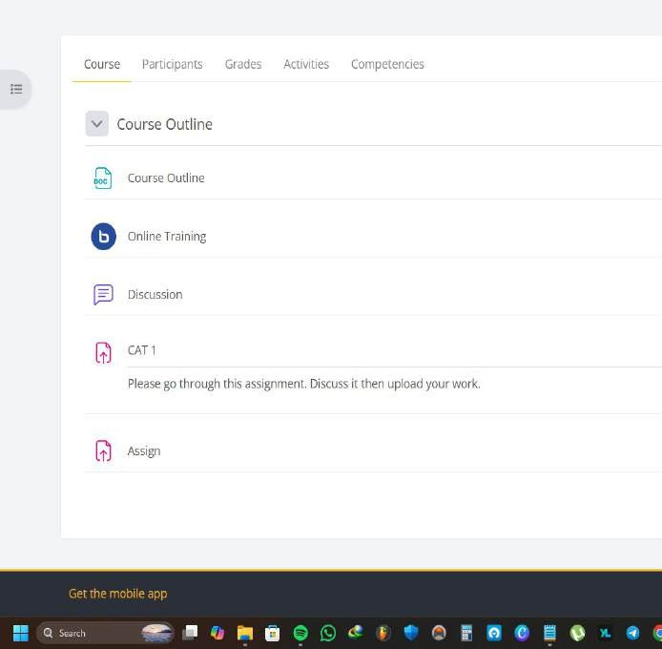
Once you have accessed the unit proceed to access the unit/course page to access the different course resources and activities

Slide 3
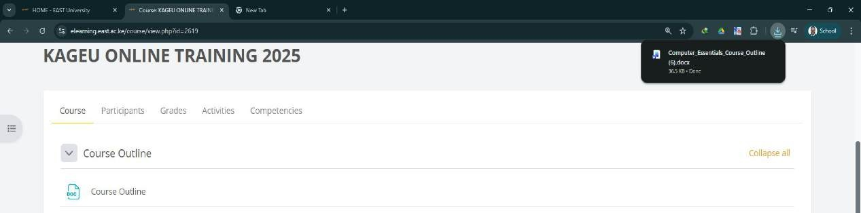
1. Notes:
Notes can either be in pdf, docx or pptx. All are accessed by clicking right next to the icon of file type the notes were uploaded as. When clicked the notes get downloaded and the default application on your device opens the respective file.
Don’t click here
Downloaded notes
Click here

Slide 4
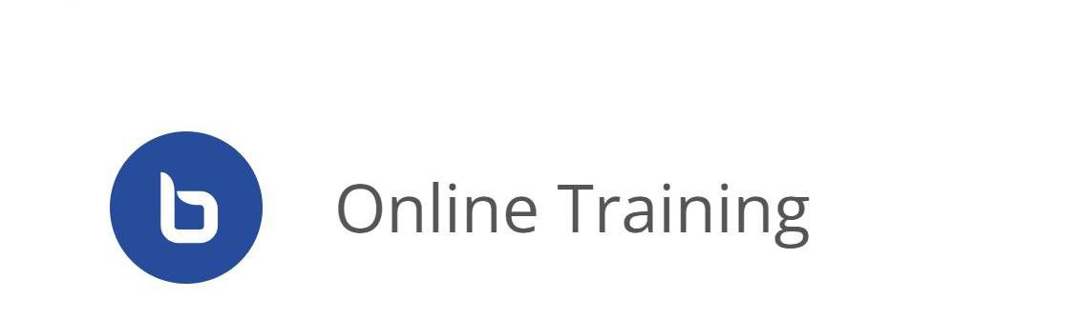
2. The BigBlueButton
The BBB is our customized online learning platform where online classes are done and where students access the different recordings. Once you see this Icon, this means that an online class has been set for a particular time for you to attend.
The BBB Icon This is where you click to access the Online Class

Slide 5
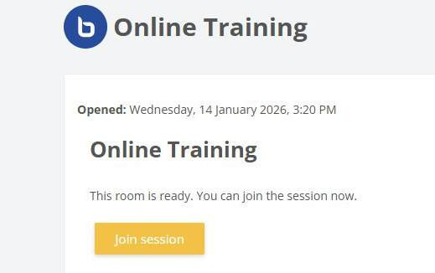
To access the online class click on the join session button and a new tab will automatically open for you to access.

Slide 6
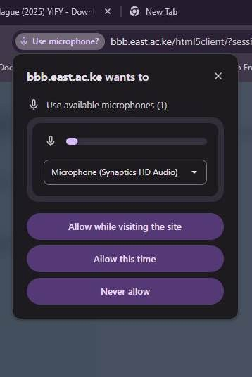
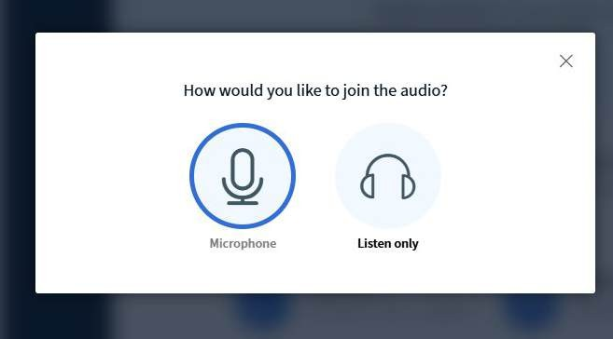
Once you have joined, you will be prompted by two options Microphone and Listen Only. Ensure you always click microphone to always be able to speak and listen during the class. Once you click the microphone, you will be prompted to allow your browser to access the microphone. Choose Allow while visiting the site every time.

Slide 7
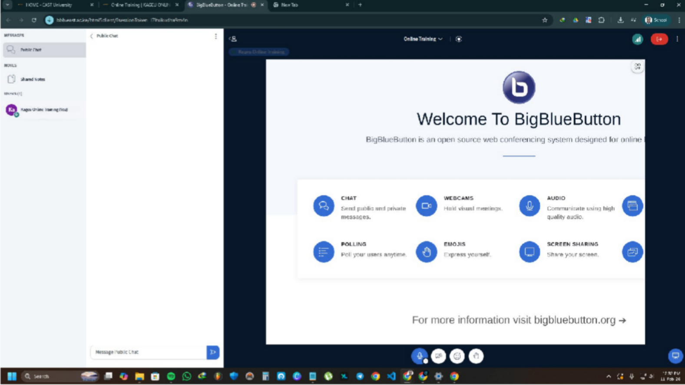
Once clicked you can access the online class.
Message chat
Microphone button

Slide 8
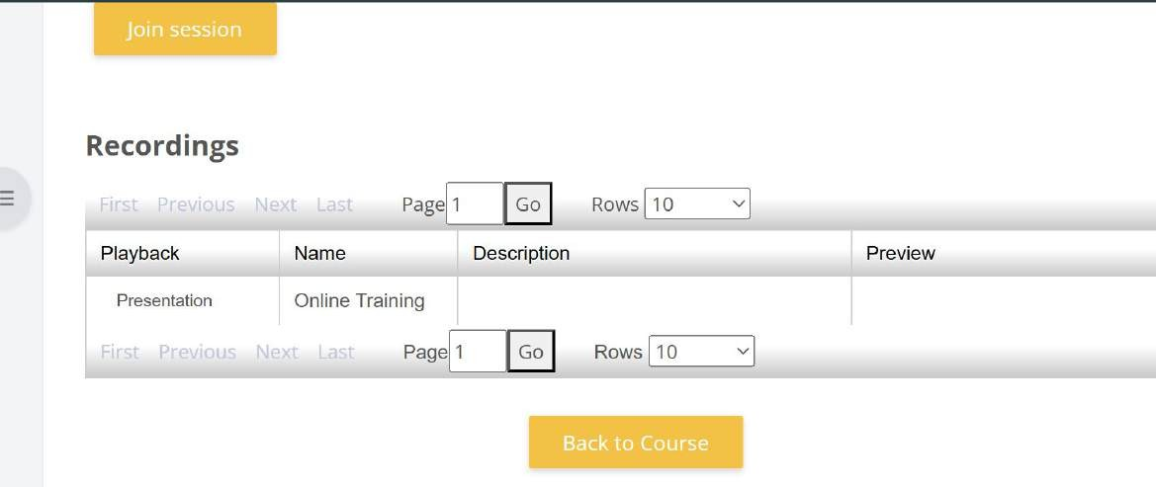
Recorded Classes can be accessed by clicking on presentation in the online class menu.

Slide 9

3. Assignments and CATS
Assignments and CATS that require to be submitted on the LMS are accessed by clicking on the assignment button.
Click here to access assignment
Assignment Icon

Slide 10
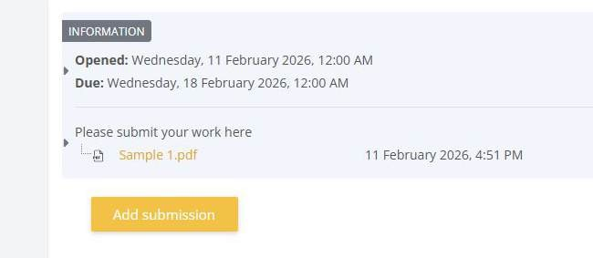
After accessing the assignment resource, You will have to click on the submitted assignment assigned by lecturer. Which is in Orange. Once clicked the work will be downloaded for you to
access.
Assignment given Download and access first

Slide 11
After accessing the work given, proceed to complete the assignment and once done, upload your wo back on the LMS. Click on the Add submission button and upload your work.

Slide 12
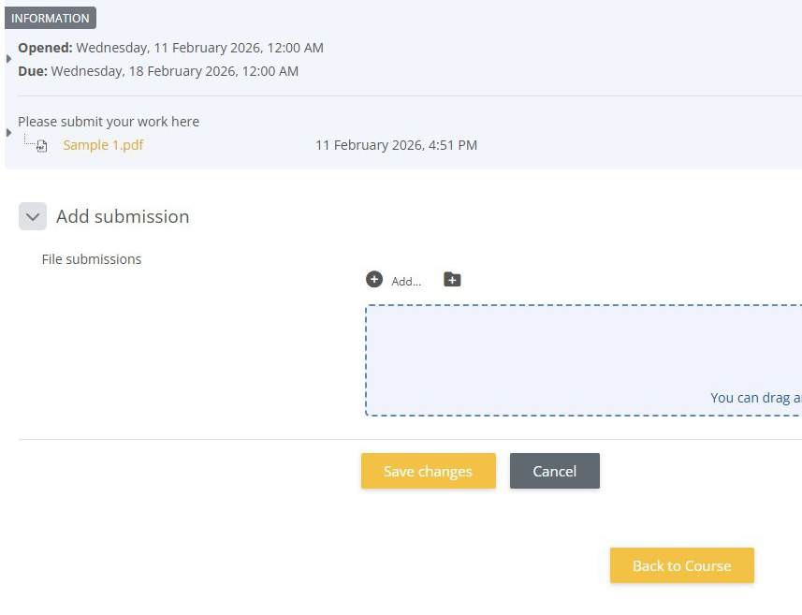
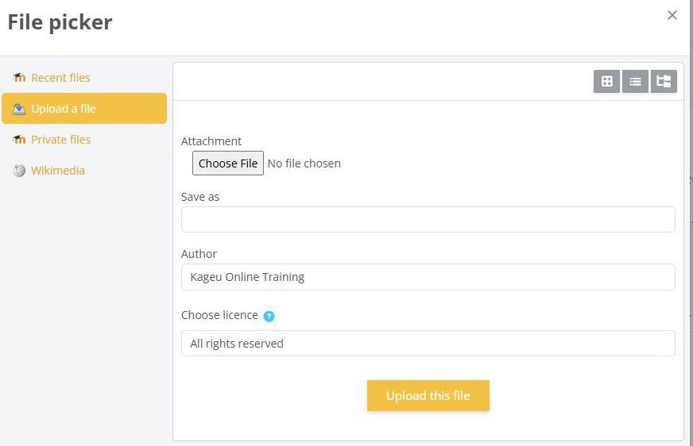
Once clicked, proceed to choose where you had saved your work and upload the file where you had done your assignment. Once selected click upload this file
Click add to go to this menu

Slide 13
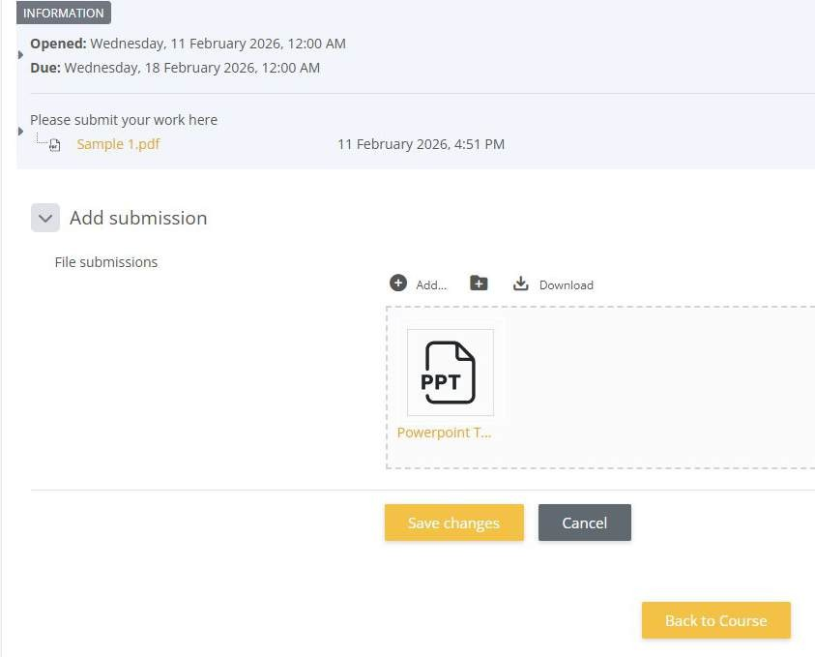
Once uploaded click on save changes to finalize submission of your work

Slide 14
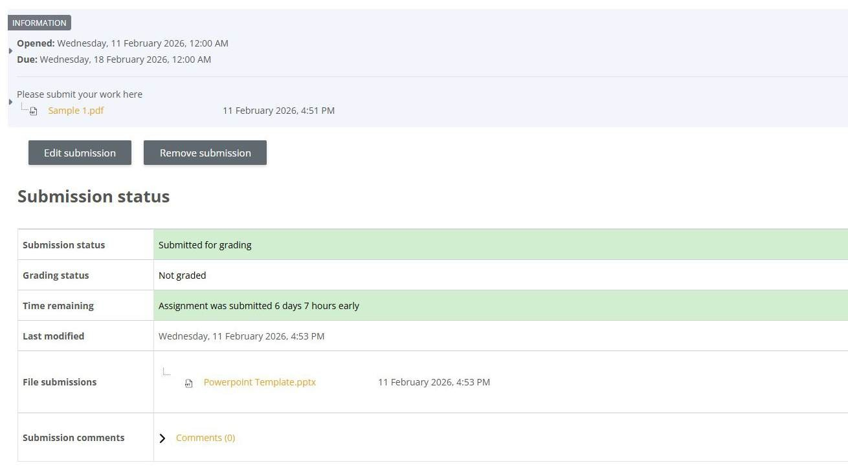
If Uploaded wrongly, or you perhaps made a mistake, you can either use edit submission or delete submission to reupload your work on the LMS.
Note that you need to submit assignments on time. Delayed submissions will be penalized.

